Slide 1
Physical modelling of embedded systems EL044A
Advanced Spice modelling
Electric/Electromagnetic and coupled physical effects

Slide 2
Physical analysis
Set of tools
Finite element method (FEM)
COMSOL Multiphysics
ANSYS
CATIA
Circuit models
SPICE
Behavioural analysis tools
Imagix 4D
Sniff+
Simulations
Mechanical
Electrical
EMC
Thermal
System dynamics
Notes:
Mec: Vibration, mechanical shocks, material properties, failures
Elec: circuit modelling
EMC: fields, generation, interfecrence
Thermal: joule heating and so on
System dynamics

Slide 3
Physical analysis
Set of tools
Finite element method (FEM)
COMSOL Multiphysics
ANSYS
CATIA
Circuit models
SPICE
Behavioural analysis tools
Imagix 4D
Sniff+
Simulations
Mechanical
Electrical
EMC
Thermal
System dynamics
Notes:
Mec: Vibration, mechanical shocks, material properties, failures
Elec: circuit modelling
EMC: fields, generation, interfecrence
Thermal: joule heating and so on
System dynamics

Slide 4
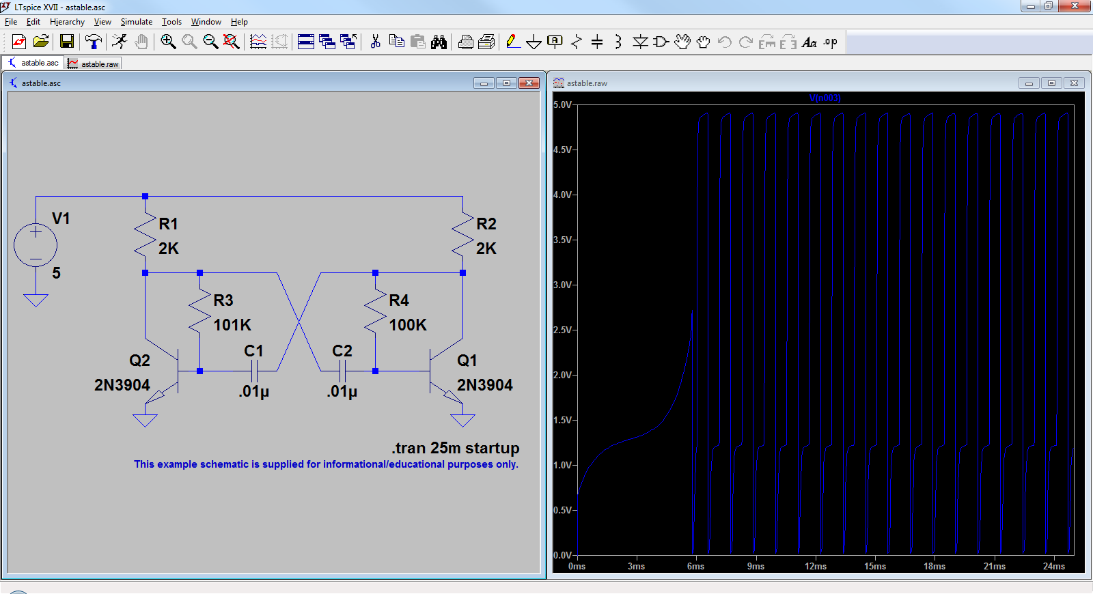
LTspice
Powerful spice simulator software from Analog Devices
Developed by Linear Technologies acquired by Analog Devices
Developed for efficient transient simulations but handles AC and DC sweeps and Noise analysis as well
http://ltwiki.org/
http://www.analog.com/en/design-center/design-tools-and-calculators/ltspice-simulator.html

Slide 5
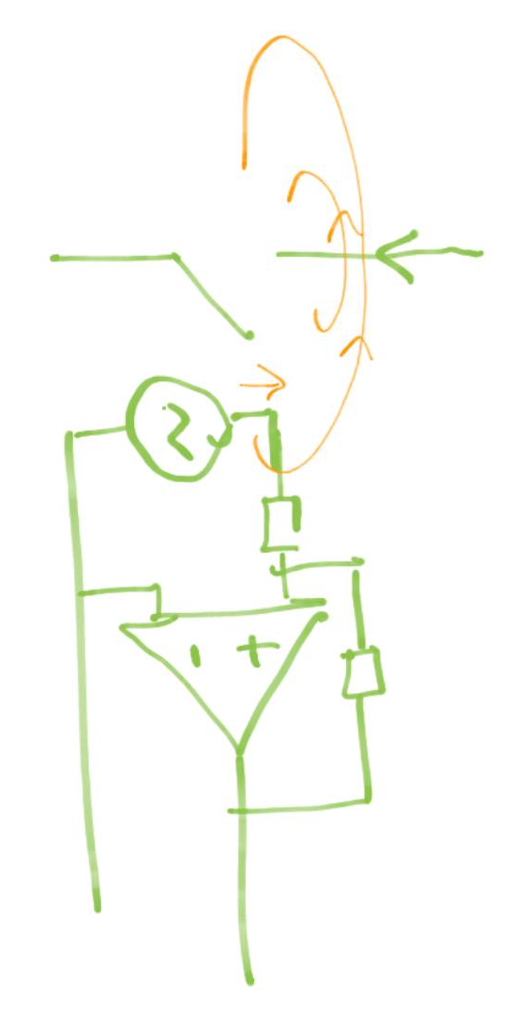
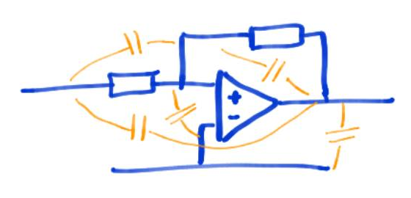
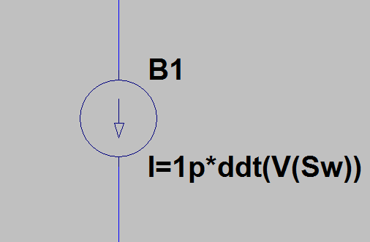
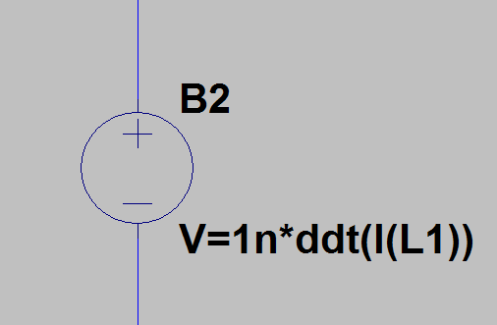


Electro / Electromagnetic coupling and EMI
Electric coupling
Potential changes in a circuit couples through parasitic capacitances
Sensitive for large dV/dt
Capacitance
Modelled in Spice as a behavioral current source
Magnetic Coupling
Current in wires induced magnetic fields that couples to other nearby wires.
Sensitive to large dI/dt
Inductance
Behavioral Voltage source in spice
$$v\left(t\right)=L\frac{di}{dt}$$
$$i\left(t\right)=C\frac{dV}{dt}$$

Slide 6
Coupled physical effects
In some cases external physical effects may affect the circuit itself and needs to be modelled for study and/or design of a system.
Examples
Losses in a device/system increase the junction temperature of semiconductor.
The resistance of a heating element changes when the temperature raises
A sensor that convert one physical unit to voltage or current
Simulation of Motors and Generators and its drives
Kinetic energy is converted into electrical energy in regeneration breaking

Slide 7
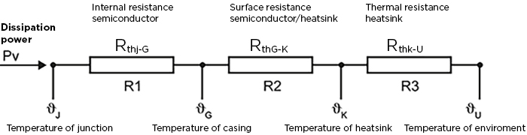
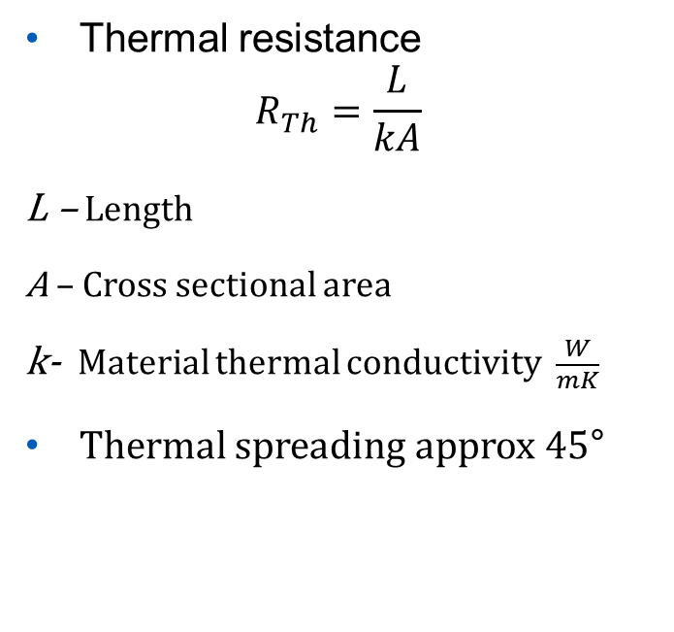
Thermal modelling
R=ρL/S
Thermal resistance
$$R_{Th}=\frac{L}{kA}$$ L – Length
A – Cross sectional area
k- Material thermal conductivity $\frac{W}{mK}$
Thermal spreading approx 45°
Notes:
Draw simple transistor, 2x2mm 0.3mm thick… Cu - Base plate 1mm 1x1 cm (limited by spreading) - Isolator 1x1 cm (spreading) – Heat sink

Slide 8
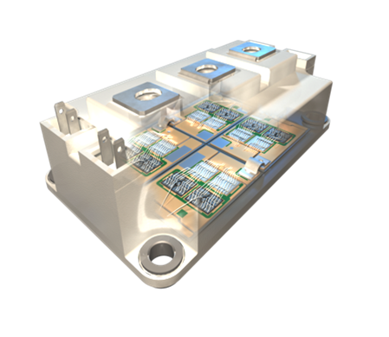
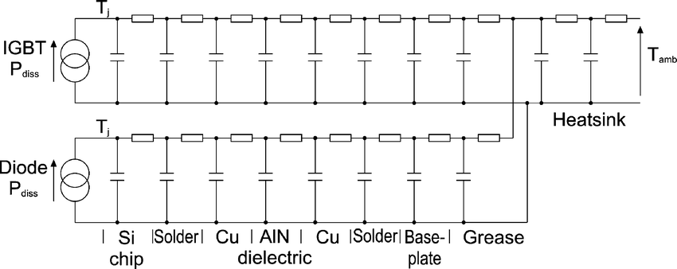
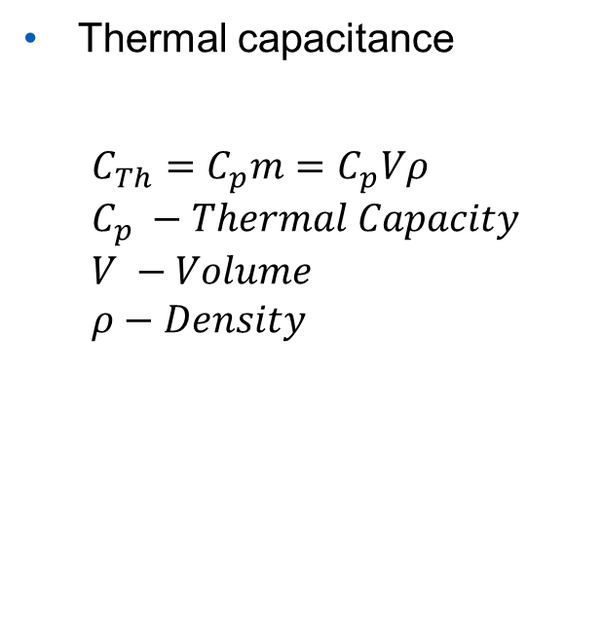
Dynamic thermal modelling
Thermal capacitance
$$C_{Th}=C_{p}m=C_{p}Vρ \\ C_{p} −Thermal Capacity \\ V −Volume \\ ρ−Density$$
m=thermal mass
Notes:
Draw and discuss a lumped part with thermal spreading

Slide 9
Coupled electro-thermal transistor modelling
Simulate first with only thermal resistance
Add thermal capacitances and surge
https://gansystems.com/wp-content/uploads/2018/02/GS66516B-DS-Rev-180213.pdf
Simulate first with only thermal resistance
Add thermal capacitances and surge(浪涌)
https://gansystems.com/wp-content/uploads/2018/02/GS66516B-DS-Rev-180213.pdf

Slide 10

High temperature resistive heating
At high T R=f(T) should be considered in an accurate model.
Variable resistance i required
Current source dependent of the voltage across it.
$$R=\frac{U}{I} \underset{⇒}{} I=\frac{U}{R}$$

Slide 11
System Analogies

